Slide 1
Personal Finance App
Linh Pham and Nixson Yeung

Slide 2
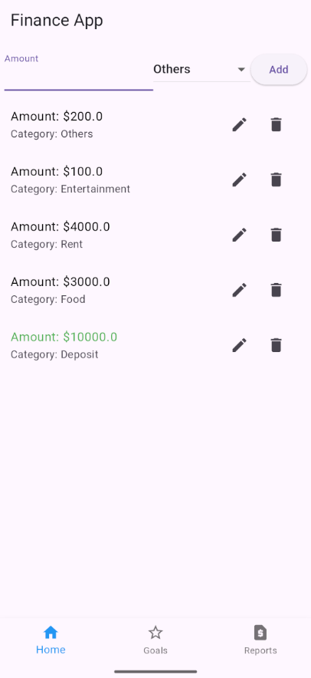
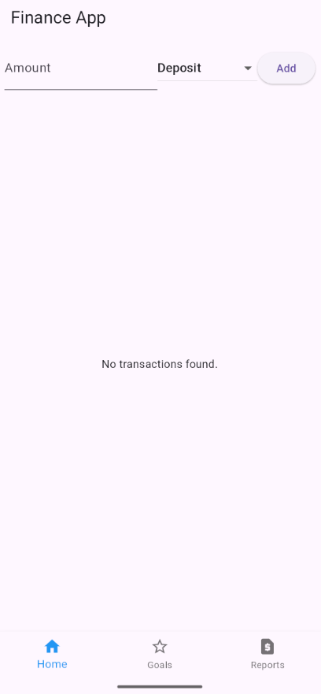
Home page
Add/Edit/Delete Transactions by category
Deposit amounts
Food Expense
Rent Expense
Entertainment
Others

Slide 3
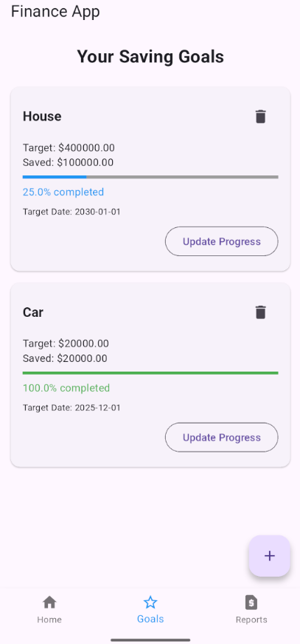
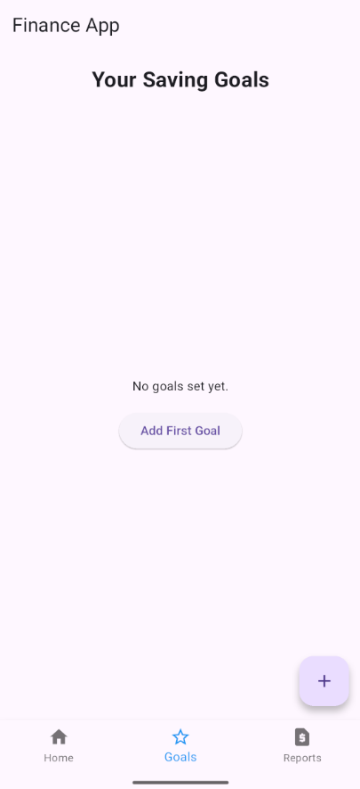
Goals Page
Add/Edit/Delete Goals
Target Amount/Current Amount
Set Dates
Shows Progress

Slide 4
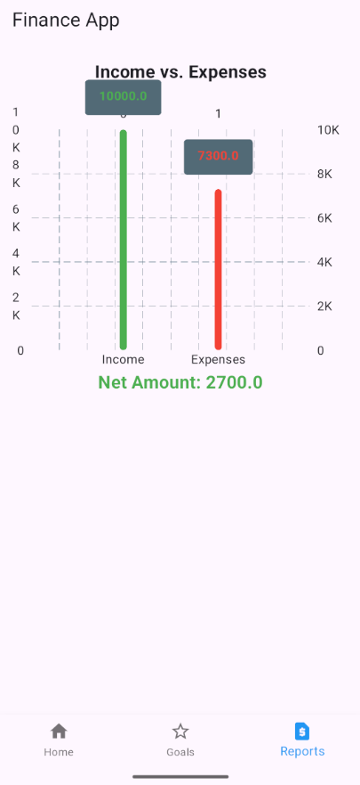
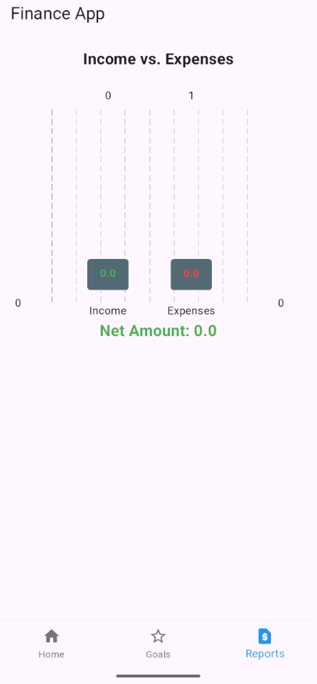
Reports Page
Shows Income vs. Expenses
Calculates Net Amount

